Slide 1
Engineering ESXi Detections Logs, Analytics, and Automation!

Slide 2
Agenda
Introduction
ESXi Architecture
Learning from Adversaries
Key Log Sources & Detections Opportunities
Build Effective Defenses
Automation
Questions & Answers
Notes:
Make prettier

Slide 3

Introduction
Senior Detection Engineer & Threat Hunter
Autodesk
Notes:
Name is Nathan Burns, I'm from Bellingham Washington and I'm a Senior Detection Engineer & Threat Hunter @ Autodesk.
Photo was pre-moustache

Slide 4
Legal Disclaimer
Notes:
Before we begin, I've got a quick legal disclaimer. Anything I say during this presentation reflects my own opinions and thoughts and not that of my employer. All research and work performed was on my own time.

Slide 5
Security Challenges
Lack of Endpoint Detection & Response and Antivirus support.
Often Considered Legacy.
Regularly Has Critical Vulnerabilities.

Slide 6

ESXi Architecture
Notes:
Before we diving into anything, let's quickly go over what ESXi is and it's architecture.
ESXi is a type 1 hypervisor, meaning it runs directly on the hardware unlike something like VirtualBox that runs inside an application.
Managed via a web interface that allows the creation of Virtual Machines and maintenance of the hypervisor.

Slide 7
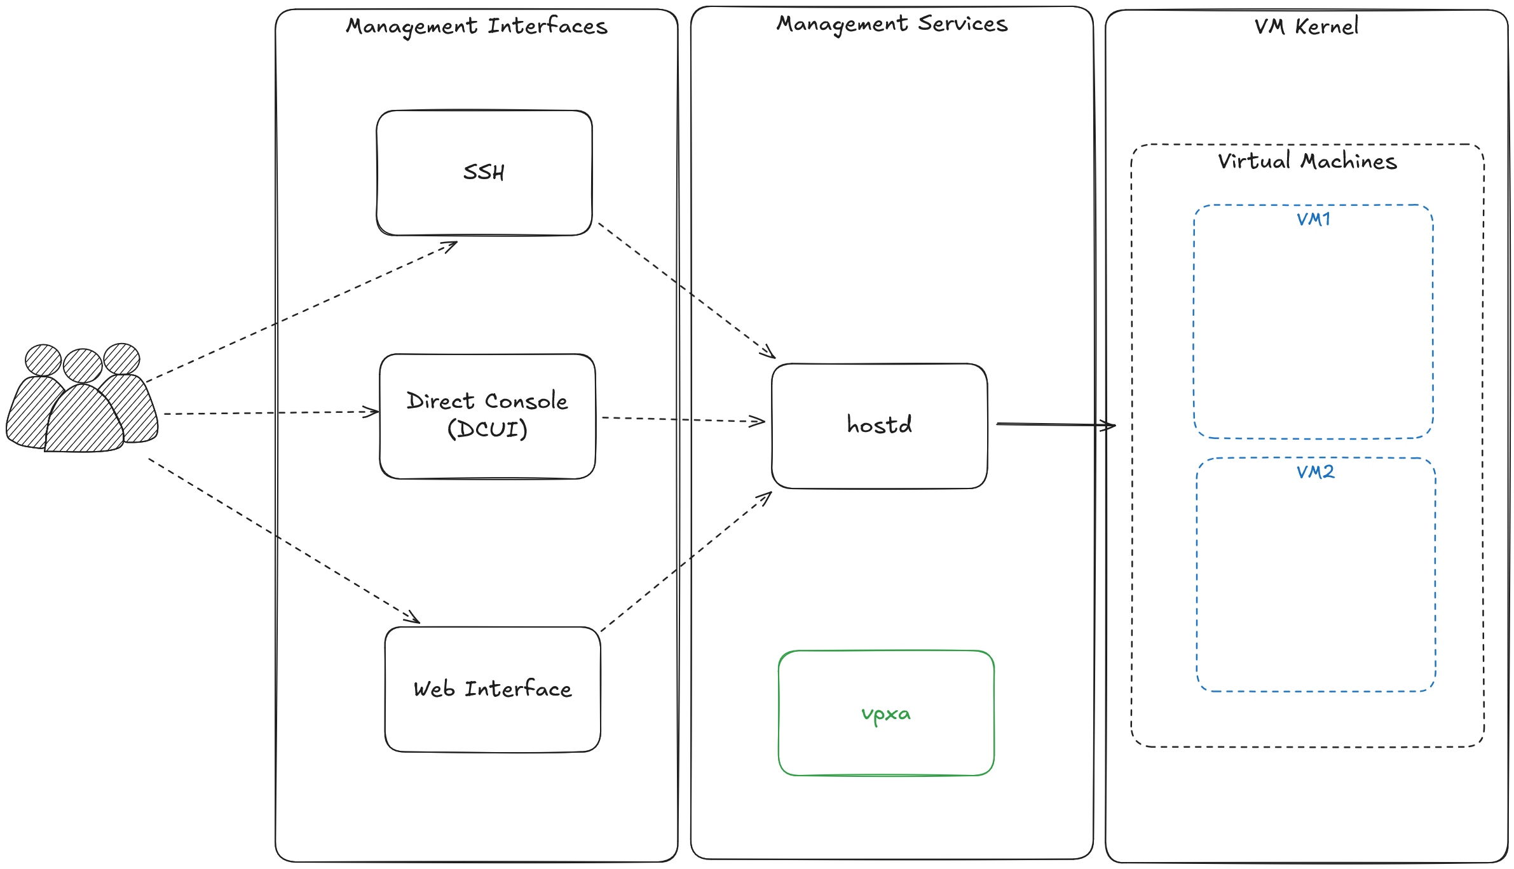
Notes:
This is a high level architecture of ESXi.
From the left to the right we can see:
Management interfaces SSH, Direct Console, and the Web Interface.
The management interfaces communicate directly with the management services, mainly hostd. VPXA is used to handle communication between ESXi and vCenter, if the ESXi server is enrolled.
The management services then finally communicates with the VM kernel which is the low-level POSIX operation system responsible for handling virtualization-related tasks. This is where Virtual Machines are located.

Slide 8
Adversary Learnings

Slide 9
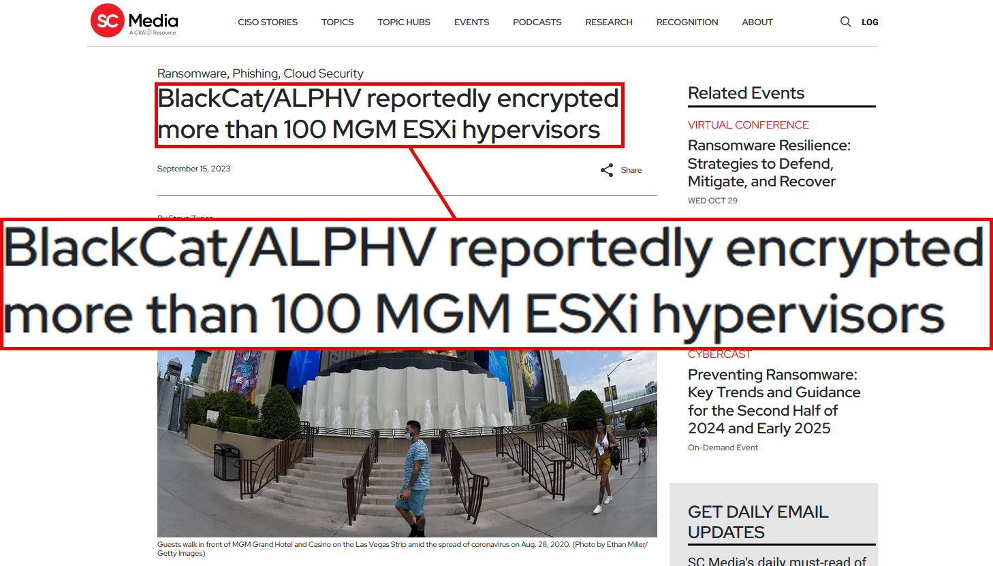
https://www.scworld.com/news/blackcat-alphv-reportedly-encrypted-more-than-100-mgm-esxi-hypervisors
Notes:
BlackCat was used by Scattered Spider in 2023 to target both MGM & Caesars, causing millions of dollars in damages.
After gaining initial access, they quickly pivoted to ESXi environments and deployed BlackCat.
Caesars paid 15 million ransom, MGM didn’t.

Slide 10
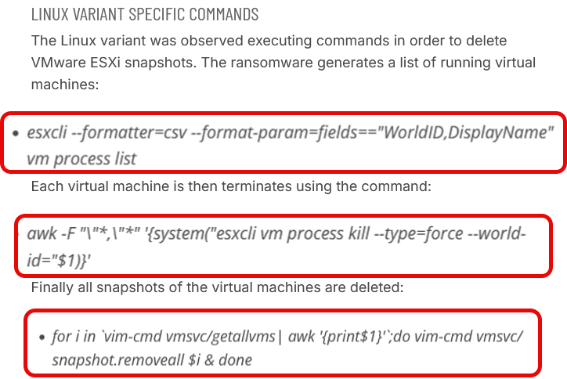
https://www.cybereason.com/blog/cybereason-vs.-blackcat-ransomware
Notes:
BlackCat enumerating VMs, killing all of them, and then deleting all snapshots. All using built-in ESXi administration tools esxcli and vim-cmd.
https://www.cybereason.com/blog/expert-support-class-action

Slide 11
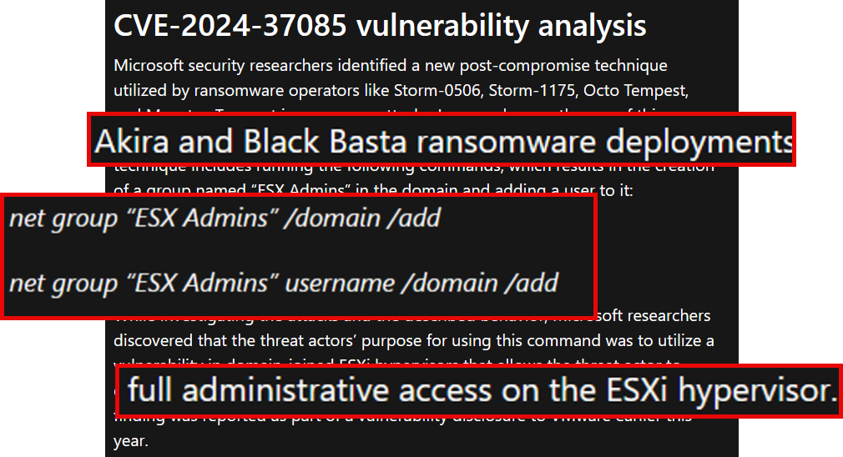
https://www.microsoft.com/en-us/security/blog/2024/07/29/ransomware-operators-exploit-esxi-hypervisor-vulnerability-for-mass-encryption/
Notes:
Several ransomware operators leverage CVE-2024-37085 to deploy Akira and Black Basta ransomware variants. This vulnerability impacted AD joined ESXi hosts where they would grant administrative access to anyone inside of the "ESX Admins" group, which did not exist by default.
https://www.microsoft.com/en-us/security/blog/2024/07/29/ransomware-operators-exploit-esxi-hypervisor-vulnerability-for-mass-encryption/

Slide 12
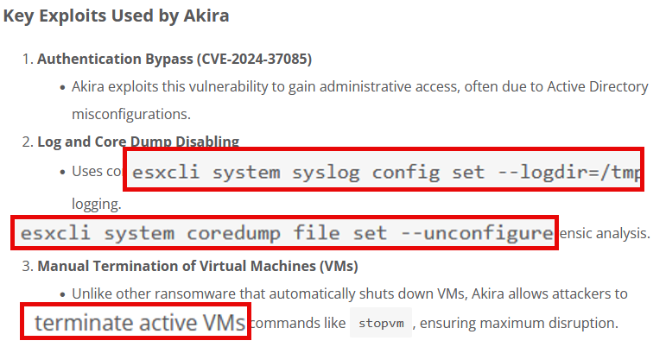
https://technijian.com/business-continuity/ransomware/akiras-new-linux-ransomware-attacking-vmware-esxi-servers-a-growing-cyber-threat/
Notes:
Some of the ESXi specific techniques used by Akira.
https://technijian.com/business-continuity/ransomware/akiras-new-linux-ransomware-attacking-vmware-esxi-servers-a-growing-cyber-threat/

Slide 13
Potential Attack Path

Slide 14
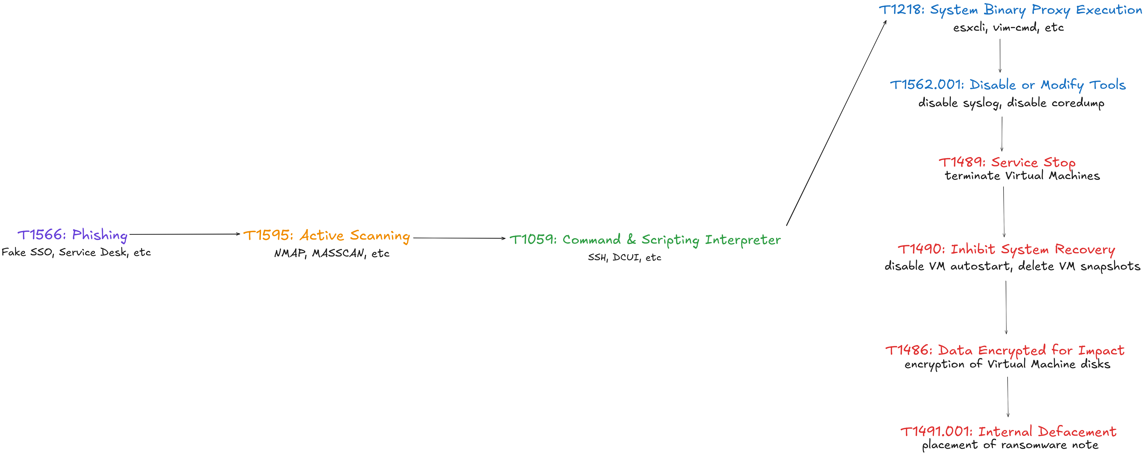
Notes:
One potential attack path

Slide 15
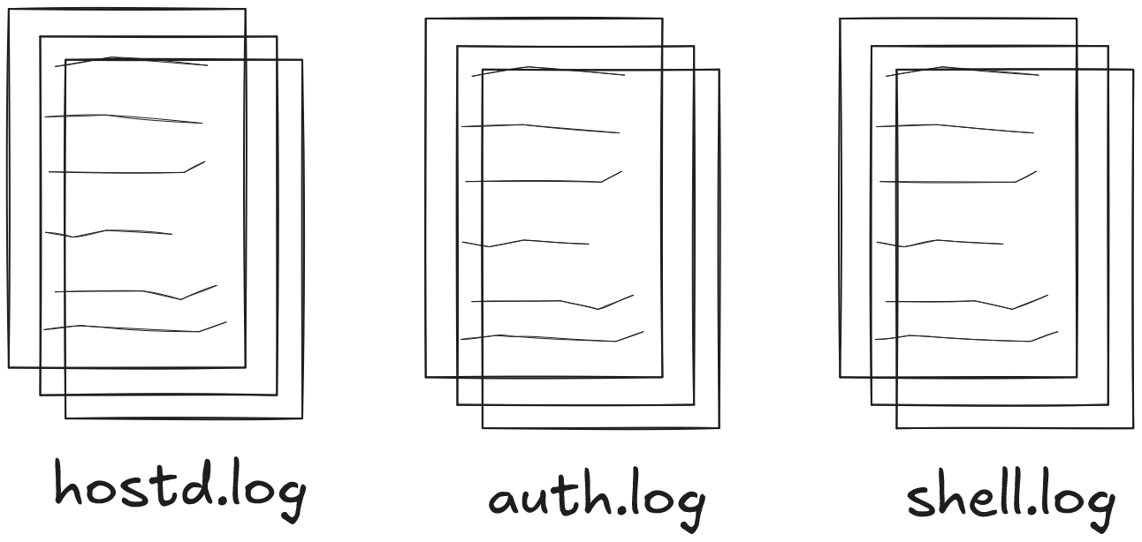
Log Sources
Notes:
Hostd.log
Covers anything that interacts with virtual machines or the hypervisor itself
Think things like disabling the firewall, enabling/disabling SSH, deleting snapshots for a VM, etc. Number one priority to ingest into a SIEM and create detections over.
Shell.log
Covers shell events on the ESXi host itself, if they were executing via DCUI or SSH. Useful for detecting non-ESXi command execution. Secondary priority.
Auth.log
Covers authentication events, but may also cover shell execution. Keep an eye on this one. Third priority.

Slide 16
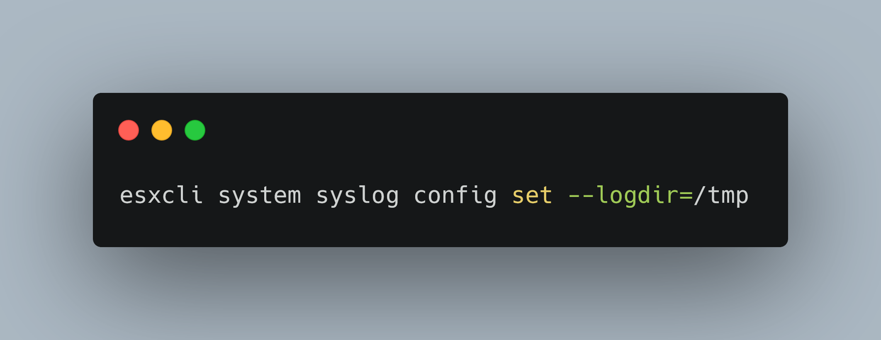
Notes:
Example esxcli command that sets the syslog directory to temp

Slide 17
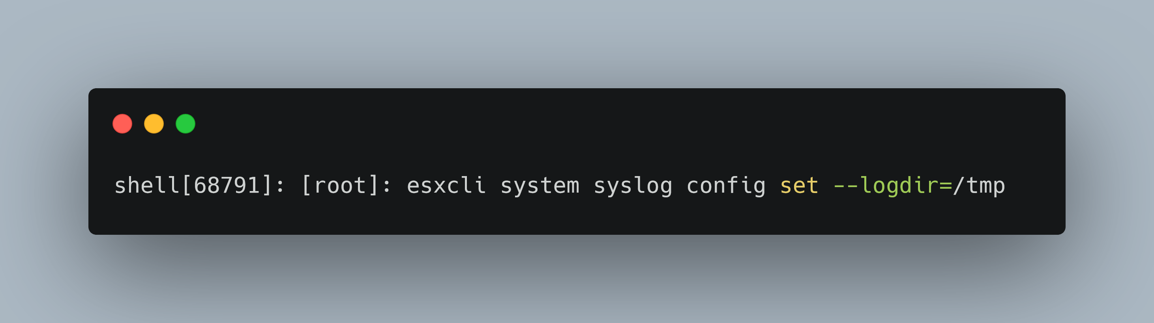
Shell.log
Notes:
You've ingested these logs, what next?
Outline some detection opportunities
Detect esxcli usage, vim-cmd usage.
Outline detecting things in hostd.log
Map log sources to adversary tactics

Slide 18
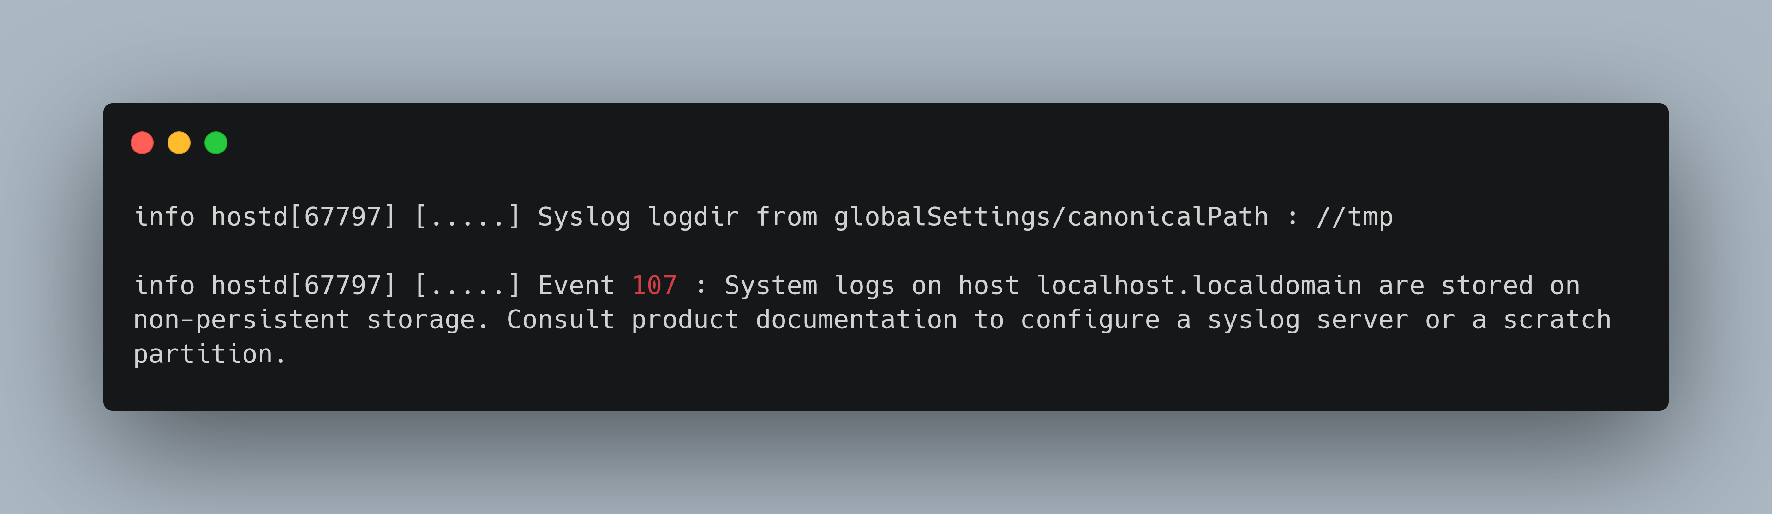
Hostd.log
Notes:
You've ingested these logs, what next?
Outline some detection opportunities
Detect esxcli usage, vim-cmd usage.
Outline detecting things in hostd.log
Map log sources to adversary tactics

Slide 19
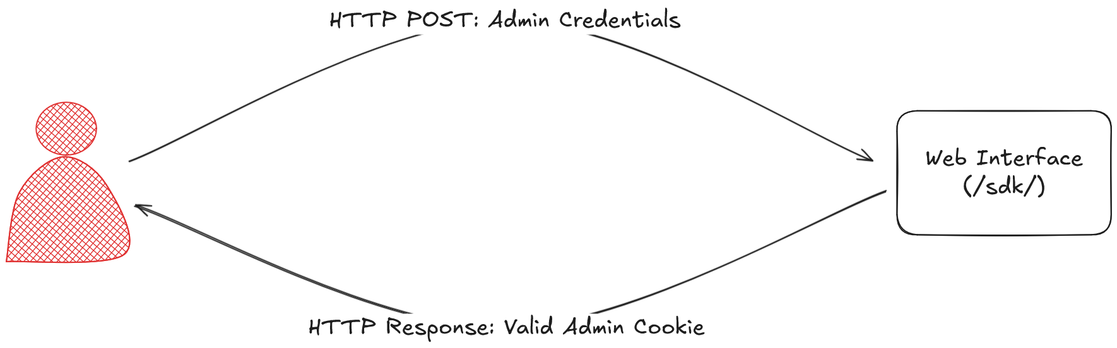
Delete VM Snapshots... but via the API

Slide 20
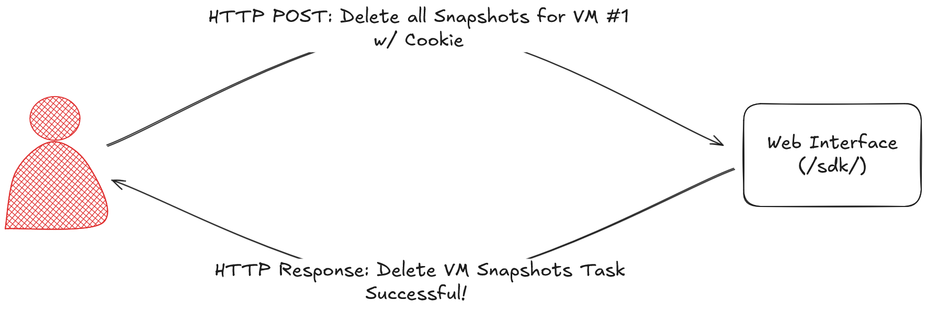
Delete VM Snapshots... but via the API

Slide 21

Shell.log
Notes:
Empty! Because we didn’t execute any shell commands, obviously.

Slide 22
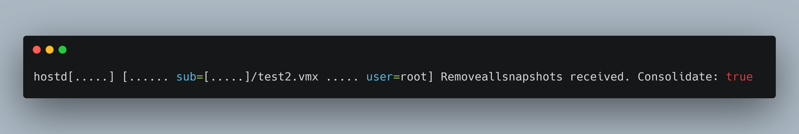
Hostd.log
Notes:
Example esxcli command that sets the syslog directory to temp

Slide 23
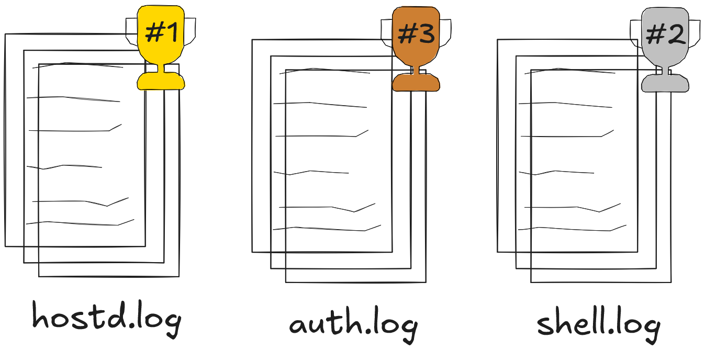
Logging Summary
Notes:
In summary, I'd order our three log sources in this way. Hostd.log should be the priority as demonstrated it'll catch everything regardless of the execution method.
Shell.log is nice for catching non-esxi related shell execution or for attributing that a given action happened on the host or remotely (different levels of severity)
Auth.log is good to ingest as well for auditing and management purposes, but the other two log sources attach a username. Knowing where that username was authenticated from could be very useful during an investigation.

Slide 24
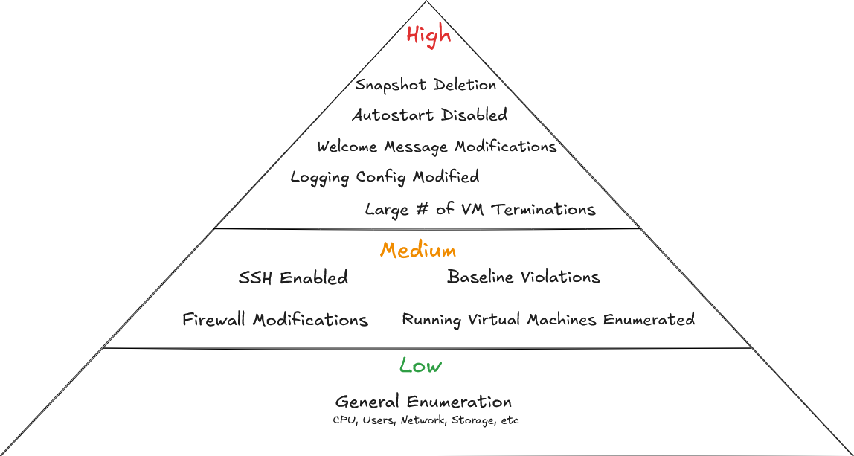
Notes:
Detection idea prioritization.
Things that correlate closely to ransomware deployment and aren't common at the top.
Abnormal actions in Medium. Baseline Violations means if your IT team never uses vim-cmd or esxcli, create generic detections for that.
Generic general enumeration actions on the bottom. Common for IT teams and can be noisy.

Slide 25
Building Effective Defenses

Slide 26
Preventions
Network Segmentation
Vulnerability Management
Keep Off Site Backups (Snapshots aren’t backups!)
Notes:
Snapshots only store data that is DIFFERENT from the original. If you lose the original or it gets encrypted, they won’t help much.

Slide 27
Automation

Slide 28
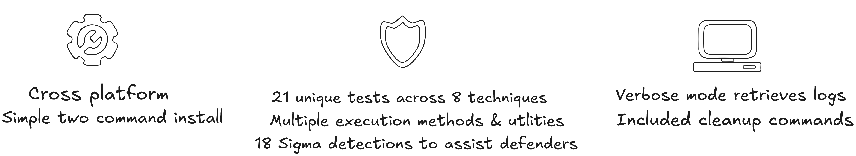
esxi-testing-toolkit

Slide 29


Slide 30


Slide 31


Slide 32

Conclusion
Adversaries know ESXi weaknesses.
Ingest hostd.log at a minimum. Create detections that indicate ransomware deployment
Prevention is a must. Segment network, patch ASAP, monitor log files
Use esxi-testing-toolkit to test detections

